Slide 1
Care Management in a College Counseling Center: A model and perspective from University of Central Florida Counseling & Psychological Services (CAPS)
Liz Stevenson, LCSW
Daniela Carter, LCSW
Yiset Perez, LCSW
June 25th 2016
Notes:
Yiset 1-3

Slide 2
CAPS Staff
Notes:
Yiset

Slide 3
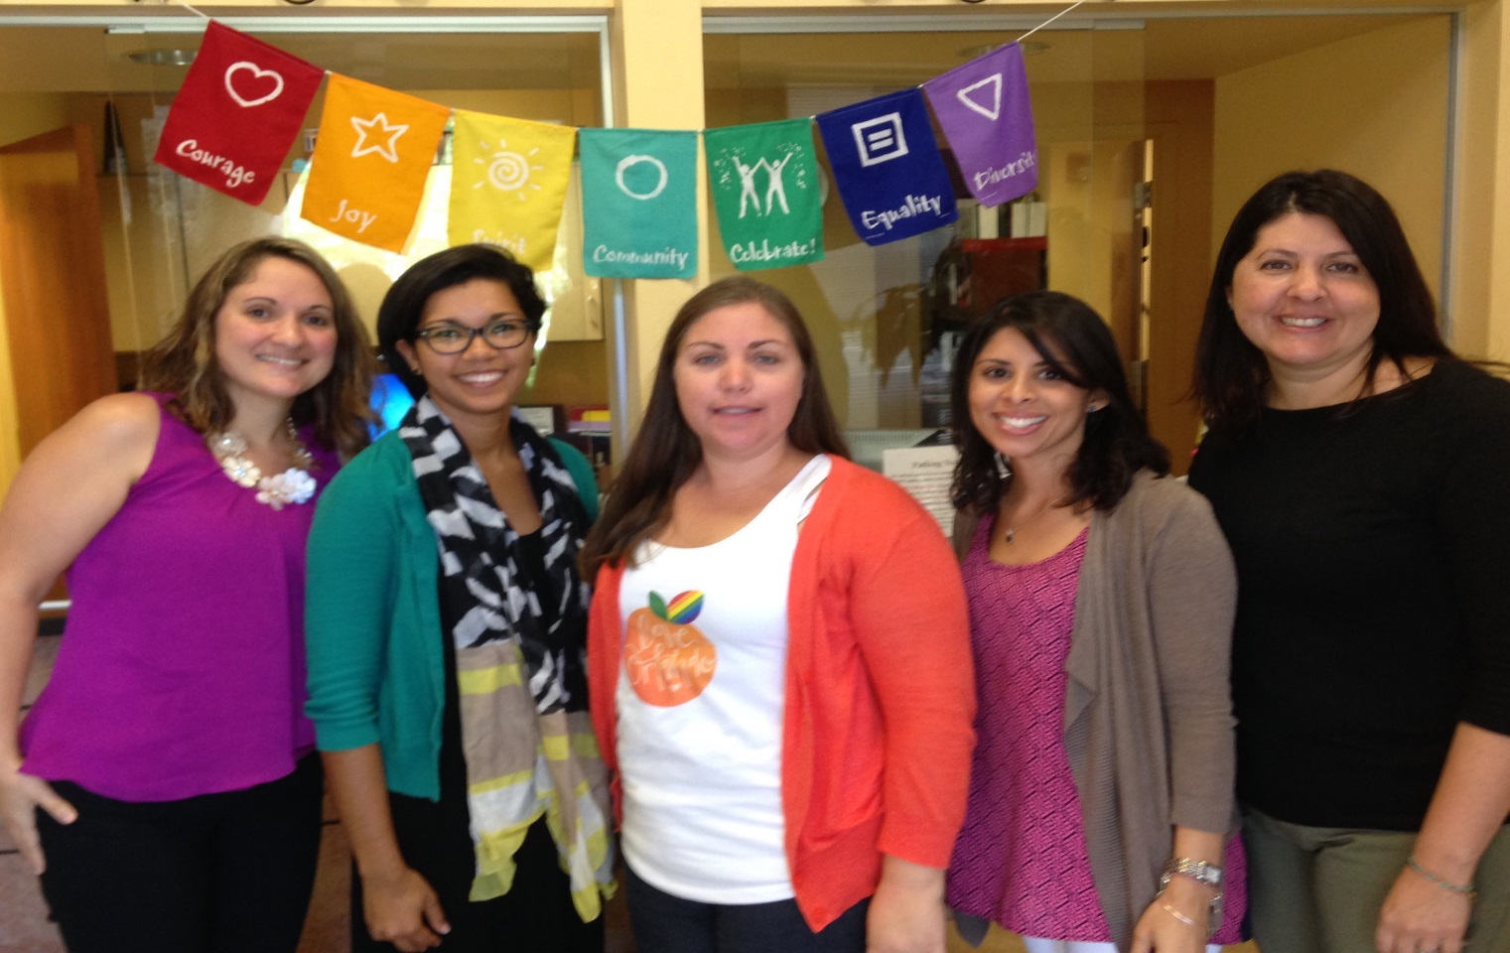
Care Management Team
Notes:
Yiset

Slide 4
Learning Objectives
1. CAPS overall framework in building a case management model (CMT)
2. CAPS’ management of internal systems, interventions, and partnerships
3. Challenges and successes of the CMT model

Slide 5
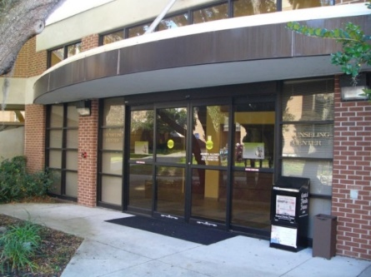
About UCF CAPS…
CAPS is located on campus, multi disciplined approx. 40 full time clinicians
Satellite locations ( College of medicine, residence halls, athletics, hospitality and management college)
UCF has 63,000 + students, making it the second largest university in the United States
Training site with 3 doctoral interns and 5 premasters interns and coming soon Post Doc program
We serviced 3909 students, 19,934 individual appointments so far during the 2015-2016 academic year
Clinical Services at CAPS provides comprehensive psychological services to the UCF community.
We provide short term individual, couples and group counseling, workshops, campus presentations, crisis intervention, animal assisted therapy, expressive arts therapy, a peer educators program, yoga therapy and other innovative interventions
Notes:
Liz

Slide 6
The complex client and the traditional service model
- High Needs
- Ongoing Safety Concerns
- Limited resources
- Frequent Contact with System
- “Falls through the cracks”
- Uses Crisis Services Regularly
- Brief or Time limited Treatment
- Bi-Weekly or weekly contact
- Large caseloads
- Triage/Walk-in/After Hours as needed
- Referrals
- Group Therapy
-Waitlists
-Staff or Trainee Level Assignment after IA
Complex Client
10% of clients
Traditional Models
Notes:
Liz

Slide 7
A Care Management Model of Care
Systemic &Therapeutic
Emphasis on Coordination of care
Assessment of situation involves planning, implementing, coordinating, monitoring and evaluating options and services
Motivation Emphasis – build motivation in students to make appropriate connections, modeling the counseling relationship, and encouraging students to seek positive change
Wrap Around Approach - initiate and organize the flow of mental health information between center and partners (on and off campus) while adhering to confidentiality and ethical standards
High Intensity of services to stabilize, monitor, connect, problem solve.
Follow Through - after-care plans , and monitors the progress of plans to ensure a successful transfer of mental health care
Notes:
CMT history and implemention – Liz

Slide 8
Care Management and the clinical system –
A Care Management Approach strengthens resources for the 10% of center clients that fall into this category
Staff Specialization for these roles – Creates a new level of assignment after intake
Strengthens stabilization resources, monitoring of risk, and continuity of care for these clients with more frequent contact, support, understanding of needs.
Shift from a “referral” model to a “wrap around” services model
Reduces the chances of students “falling through the cracks” by strengthening partnerships with campus and community resources
Works side by side with campus partners (Health, conduct, student services, local hospitals, private practitioners)
Goes beyond the immediate risk assessment and meets ongoing needs
Notes:
Liz

Slide 9
Identifying the CMT client
The client that falls in the high risk category (approx. 10% of Clients)
Recent hospitalization or suicide attempt
Hx of suicide attempt/s
Psychosis
Substance abuse
Current high risk behaviors
Current or recent suicide ideation with intent and plan
Low motivation/Compliance
Low insight
Limited Resources
Connected to multiple departments
Frequent contact with system
Regular use of crisis services
Notes:
Daniela

Slide 10
Entry into our system and developing the CMT Process – A New Path
IA/TA Recommendation
1 session referral
Individual Counseling
CMT
Extended IA to gather more info
First Ongoing Session
4-6 sessions
Group/Workshops Screens
First Ongoing Session
4-6 sessions
Risk Monitor/Stabilization
Motivational Interviewing
Wrap Around Services
Notes:
Daniela

Slide 11
Theoretical Approach within CMT Model
All models below are within a short term therapy framework and used simultaneously with case management services
Motivational Interviewing (MI)
Strengths-Based Therapy
Solution-Focused Therapy
Cognitive Behavioral Therapy (CBT)
Mindfulness Based Cognitive Therapy (MBCT)
Acceptance Commitment Therapy (ACT)
Dialectical Behavioral Therapy (DBT)
Notes:
Solution Focused Therapy - student works on focusing on present and the future and is goal directed focusing primarily on the solutions vs. the actual problem. This works by addressing what clients want to achieve and exploring the history and provenance of problem.
Motivational Interviewing- used with the therapist taking an active role in eliciting and strengthening the student’s motivation for change. Within this approach, the students’ ambivalence is explored and resolved. The students’ level of motivation for change needs to be considered here in order for treatment to be effective.
Strengths Based Therapy - a specific method of working with and resolving problems experienced by the presenting person. It does not attempt to ignore the problems and difficulties. Rather, it attempts to identify the positive basis of the person’s resources (or what may need to be added) and strengths that will lay the basis to address the challenges resulting from these problems.
Cognitive Behavioral Therapy (CBT)- student works on identifying and changing irrational thought patterns and behavior to more rational thinking and behaviors.
Dialectical Behavioral Therapy (DBT) – originally developed by Marsha Linehan to treat chronically suicidal individuals diagnosed with borderline personality disorder (BPD) and it is now recognized as the gold standard psychological treatment for this population. Students learn mindfulness based skills to increase distress tolerance, regulate emotion, gain interpersonal effectiveness
Acceptance and Commitment Therapy (ACT) - form of clinical behavior analysis developed by Steven Hayes. Students benefit from this empirically-based psychological intervention that uses acceptance and mindfulness strategies mixed in different ways with commitment and behavior-change strategies to increase psychological flexibility.
Mindfulness Based Cognitive Therapy (MBCT) – designed to aid in preventing the relapse of depression, specifically in individuals with Major depressive disorder. MBCT was developed by Zindel Segal, Mark Williams and John Teasdale, based on Jon Kabat-Zinn’s Mindfulness-Based Stress Reduction program.

Slide 12
Internal Systems, Interventions
Administrative Task:
Risk Track Monitoring
Referrals
Liaisonships with local hospitals, departments, resources
Consultants to student of concern committee or other campus meetings
Evaluating our services:
CMT Triages daily
CMT Rounds weekly
Treatment teams
Innovative services – DBT group, mindfulness for depression, Autism Connections, community provider data base and open house
Trends
Notes:
Yiset

Slide 13
Connections/Partnerships
On Campus
Student health Services-Psychiatry, medical evaluations, dietician, women's health, lab works, insurance
Eating Disorder Management Team- medical evaluations leading to other services
Substance Abuse Treatment Team- AOD screening, assessment and treatment
Care Management Treatment Team
Student Care Services ( Student of concern committee)
Other departments on campus based on need
Therapist Assisted Online (TAO)
Trans Care Team
Off Campus
Community Provider Database (CPD)
How to Shop for a Therapist form
Pro bono services if appropriate
Central receiving units for Baker Acts- liaisonship with University Behavioral Center (UBC)
Student Care Services (SCS)- after hospitalization process
Community Counseling Clinic, Psychology Clinic
Student Accessibility Services (SAS)
Student Veterans Services (VARC)
Bus/transportation
Knight’s Pantry services
Zip Car
Notes:
Yiset

Slide 14
Successes and Challenges
Challenges
Clinician risk aversion- High Risk = CMT
Possible Clinician burn out (risk, risk, risk, and more risk)
Scheduling challenges
Determining disposition- CMT or non-complex referral off
Non-compliance from students
Lack of client motivation for treatment- long term referral
Lack of insight
Lack of resources
Staying on top of University trends and initiatives ( global UCF, Inclusive Education Services) and being prepared.
Notes:
Daniela

Slide 15
Successes and Challenges
Successes
Provides consistent and frequent follow up care for students
Allows for flexibility in treatment approach
Allows for the ability to identify high risk students sooner
Treatment team approach in connecting with other on and off campus providers
Therapist serves as an advocate for the student
Continued growth of team and strong support from admin
Counseling and Psychological Services, Student Health Services-Psychiatrist and Student Care Services Outstanding Collaborative Effort 2016
Notes:
Daniela

Slide 17
Questions

