Slide 1
Case Management with Titanium
Presented to the
Higher Education Case Managers Association
June 19, 2018

Slide 2
What is Titanium Schedule?
EMR originally designed for college counseling centers
Wide variety of users:
Counseling
Disability
Academic Advising
Advocacy
Student Affairs
A few facts
Company founded in 1998
In over 1250 centers
US and around the world (e.g. Canada, Australia, England, Qatar, Singapore)
Only 12 Titanium staff members

Slide 3
But for case management?
More than just a calendar…
Appointments
Notes
Forms
Attachments
Diagnoses
Configure:
Appointment codes
Note types
Forms
Flags
Optional features

Slide 4
But for case management?
More than just a calendar…
Reports:
Total and new client counts
Appointments, hours
Caseload, weekly activities
Disabilities/accommodations
From forms:
Demographics
Presenting challenges
Resources
Case disposition

Slide 5
Where are Case Managers?
Counseling
Student Conduct
Academic Advising
Disability
Housing / Resident Life
“Case Management in Higher Education” Joint Publication of National Behavior Intervention Team Association and American College Counseling Association

Slide 6
Counseling Workflow
Intake
Treatment
Termination
Yes
Assessment
Can we provide services?
Refer
Follow up and Track
Evaluate
Termination
No

Slide 7
Counseling Workflow
Helpful Titanium features:
Data form: presenting issue, referrals made, outcomes
Placeholders associated with students: to remind the manager to do follow up activity or create appointments
Waitlist: brief notes on follow up activities that aren’t appointments
Flags: advanced client search to review clients who are receiving case management services
Assessment
Can we provide services?
Refer
Follow up and Track
Evaluate
Termination
No

Slide 8
Student Conduct Workflow
Case Referral
Make recommendations
Monitor sanction completion
Close case
Gather information

Slide 9
Student Conduct Workflow
Helpful Titanium features:
Non-Client Notes: For documenting information from other sources before referral occurs
Data form: Sanctions and completions
Note attachments: Emails and information from other campus resources
“Other” appointments: Track meetings that don’t involve students
Case Referral
Make recommendations
Monitor sanction completion
Close case
Gather information

Slide 10
Academic Advising Workflow
Initial appointment
Assist in creating schedules, degree plan
Schedule follow up, if required
No
Is student “high risk?”
Assess reasons for risk
Determine resources, and refer
Follow up, schedule ongoing appts
Return to normal advising track
Yes

Slide 11
Academic Advising Workflow
Helpful Titanium features:
Data form: presenting issues
Appointment codes: To differentiate activities
Waitlist: brief notes about referrals and follow up activities related to referrals
Is student “high risk?”
Assess reasons for risk
Determine resources, and refer
Follow up, schedule ongoing appts
Return to normal advising track
Yes

Slide 12
For everyone
Multiple user permission levels - restrict access to confidential information
Web component – allows students to complete forms on tablet or computer
Appointment reminders – reduce “no show” rate
My Clients list – See all of your clients in a single screen
Task List – Reminders to mark appointment attendance and complete notes

Slide 13
Demo
Using the waitlist
Placeholders associated with clients
Notes and data forms
Non-client notes
Reports
Appointment counts
Data form reports

Slide 14
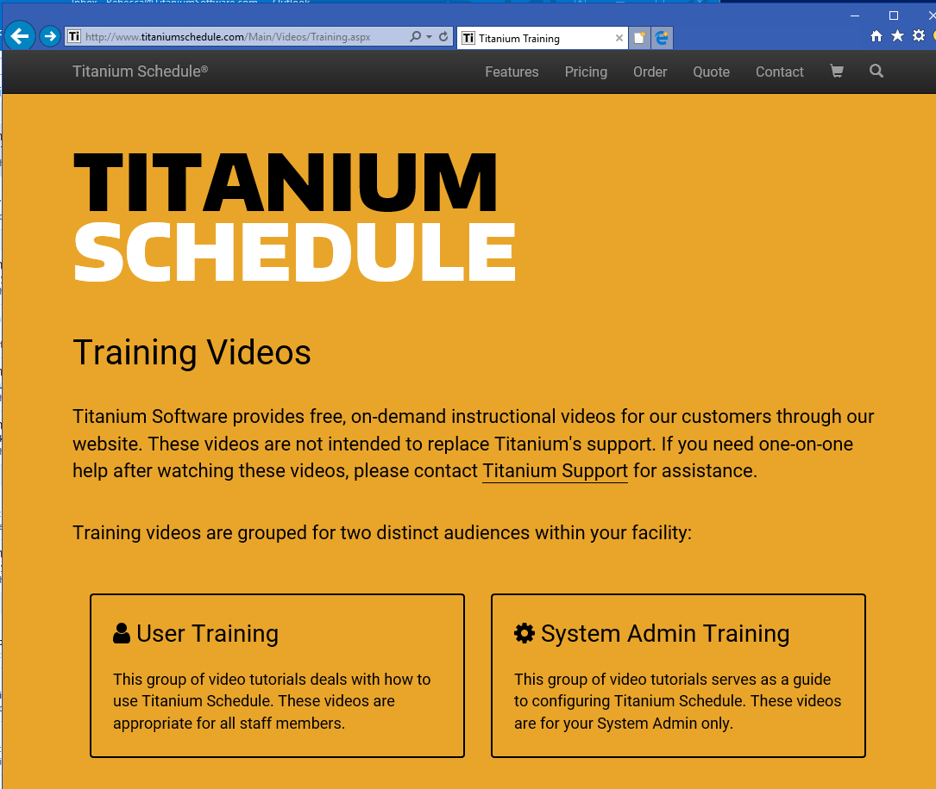
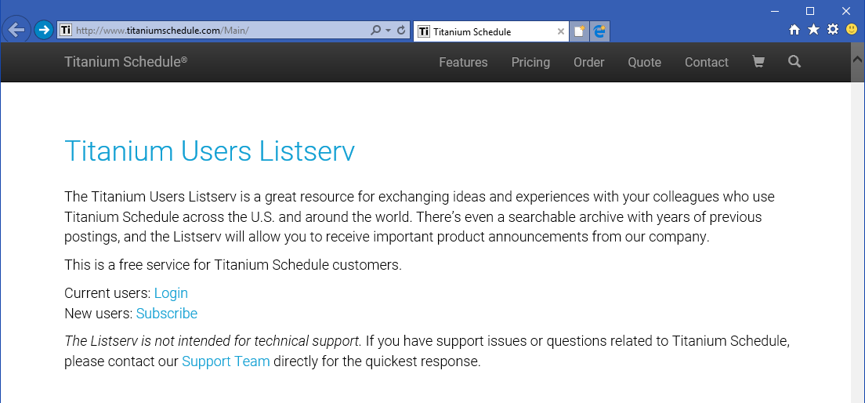
Before the demo…Tools
Titanium website
Training at the Titanium website
ListServ

Slide 15
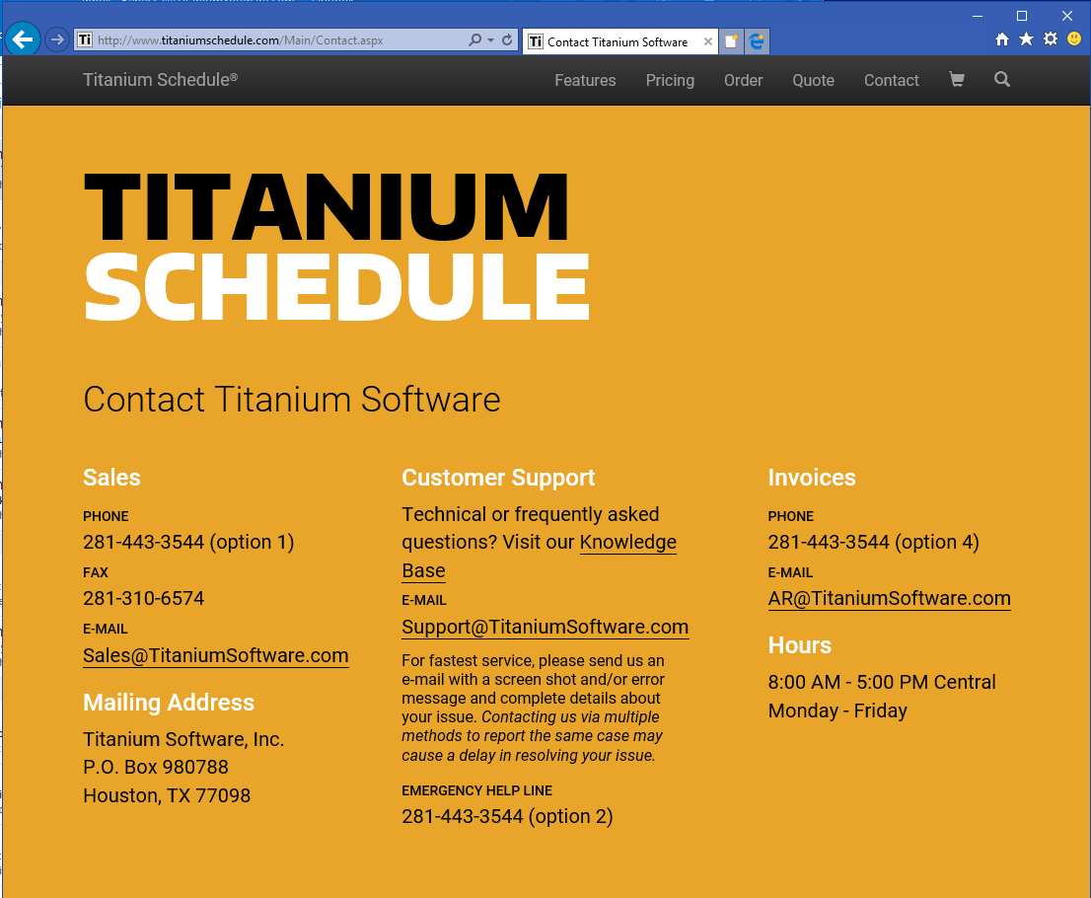
Before the demo…Tools
Titanium website
Training at the Titanium website
ListServ
Titanium Support team
Part of your license fee
Support@TitaniumSoftware.com

Slide 16
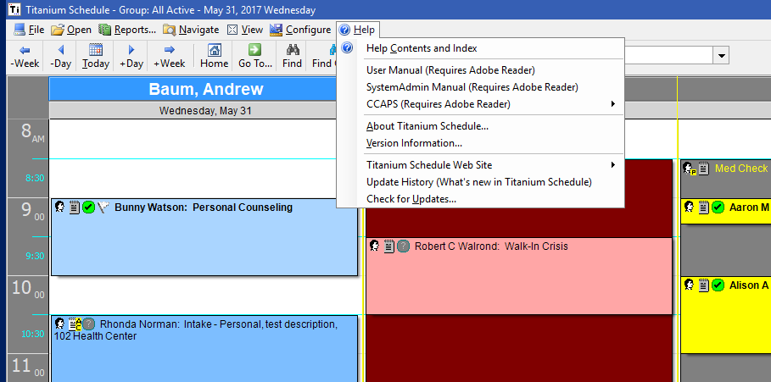
Before the demo…Tools
Titanium website
Training at the Titanium website
ListServ
Titanium Support team
Part of your license fee
Support@TitaniumSoftware.com
In software
Help
Manuals

Slide 17
Your questions answered…
Titanium Demostration
Open question/answer

