Slide 1
Leveling up: Navigating the Leadership Pipeline
JJ Larson
Associate Director
Student Services for Health & Wellbeing
Richland College

Slide 2
Think of a favorite supervisor…
What did you admire most about them?
Text messaging
Presenter session: Audience textsJJLARSON893 to 22333 to join the session, then they text a response.
Notes:
>> https://www.polleverywhere.com/free_text_polls/af7ZHcr1h3qrEK1

Slide 3
Leveling Up is the Journey
From individual contributor
To manager
To manager of managers

Slide 4
Each intersection requires different interactions based on
Different thinking
Different feeling
Different behavior

Slide 5
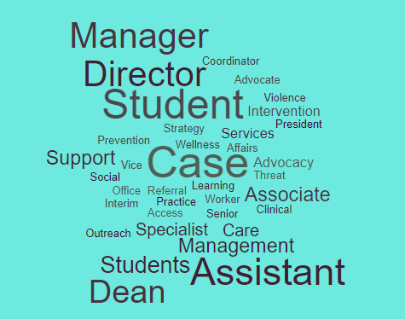

Slide 6
In student affairs the journey might look like..
Case Manager
Director
AVP of several areas
Associate Dean
Program Coordinator

Slide 7
Making the Journey
MINDSET SKILLSET
What …..… is needed to move from X to Y?

Slide 8
Level Up Your MINDSET
Take in the view from an employee perspective: what do they see
Stop being a solutions provider: growth vs fix
Shift to a constructive tone: how are you heard
Be the leader employees want to follow: what you say & do = trust level

Slide 9
Level Up Your MINDSET
Delegate and divide: empower and value
Look to others: find a mentor
Change how you discipline/ manage conflict: listen, respect, flexibility
Work to inspire your team: improve your skills & keep team in loop
Notes:
Embarrassing over-communication
Repeat self to point of almost feeling hung up.
Delegate Delegate: always be thinking about how to take one’s self off the critical path

Slide 10
Essential Management SKILLSET
Interpersonal
Operational
Financial
Human Resources

Slide 11
Management Skillset: Interpersonal
          Accountability
          Advocacy
          Accountability
          Communication
          Cultural Competency
          Education, Training
          Self-Development

Slide 12
Management Skillset : Operational
Information Technology
Organizational Awareness and Practice: male & female
Performance Improvement
Professionalism and Ethics
Understanding Consumers and Supports

Slide 13
Management Skillset : Financial
Financial Skills & Budget Management
Standards and Regulations

Slide 14
Management Skillset: Human Resources
Recruitment, Training, Retention
Performance Management
Leveraging Collaboration

Slide 15
Building a road map to get skills means also understanding scope of those skills

Slide 16
MICRO
MESO
MACRO

Slide 17
The Leadership Pipeline is the intersection of the changes that move you to the next level
Lets go back to cp lists..

Slide 18
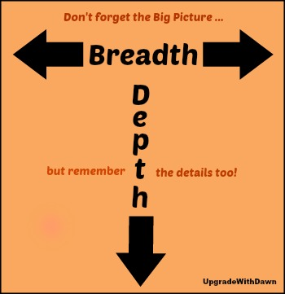
Intersection of Skills

Slide 19
The most difficult change for managers to make at Passage One involves values. Specifically, they need to learn to value managerial work rather than just tolerate it.

Slide 20
Putting Breadth & Depth into context
TECHNOLOGY
BUDGET
Notes:
For levels of management .. Skills needed and eectation hekd CANGES as level changes

Slide 21
To level up learn how other areas work to get view out of your channel
What are ways to gain breadth and depth needed?

Slide 22
Examples: How to Build B&D
Breadth
Lead a project
Train, teach, coach, mentor
Depth
Increase conflict management skills: having crucial conversations
Budget development – for project or expenditure justification

Slide 23
PLANNING SHEET
Where are you versus where you want to go?
What skills do you need for that change?
Where do you need to target your professorial growth?

Slide 24


