Slide 1
HECMA Membership Survey: Patterns and Trends
Presented by:
Jennifer E. Henkle, LMSW (Jennifer-Henkle@utc.edu)
Beth Riley, MA, LMSW (Briley@Binghamton.edu)
Notes:
Introduce selves
Chair and member of the HECMA Quality Improvement team

Slide 2
Poll Everywhere
Visit PollEv.com/binghamtonu
Send a text to “37607” containing “BINGHAMTONU”

Slide 3
Salary Analysis
Notes:
B

Slide 4
Notes:
B: Those in a clinical setting made on average $1,800 more than the non-clinical peers
Clinical average salary $61.5k
Non-Clinical average salary $59.7k

Slide 5
Notes:
B
Case managers/Care Mgrs are 28.1% of respondents
Clinical case managaers/care mgr = 16.9% of respndents
Or a total of 45% of all respondents
Most of the Assoc./Assist. Dean’s and Directors make 60 – 69K
Coordinators have a broad range spread from 39 – 88k with no significant percentage in any one area
Case and Care managers:
11% have a salary under 40k
33% salary in the 40 – 50k range
28% in the 50 – 60k range
19% in the 60 – 70k range
5% make 71k
One student affairs case manager makes 98,000

Slide 6
Range of multiple responses
Single response
Notes:
B
Blue: The blue line/point means that there was no salary range because for that state there was only one salary.

Slide 7
Notes:
B
Given the current cost of living in Canada it’s no surprise that the salary is higher.
However, I adjusted the Canadian salary based upon the currency rate in March of this year and it still is higher than salaries in the U.S.
Why do you think this is?
0.84 USD equals 1 CAD
84% of 98 = $82
84% of 68 = $57

Slide 8
Notes:
B
We have many case managers with bachelors degrees with additional years of experience, therefore I am not surprised by how close the salary is to masters level.
However, I was surprised by the difference between masters and doctorate.
Any hypotheses?

Slide 9
Respondents
Notes:
J
2012 survey: 167 responses (ranging from March 2012 to March 2015)
2015 survey: 89 responses (ranging from May 2014 to April 2015)

Slide 10
Notes:
J
2014 survey
While the overwhelming majority identified as “mental health” many also noted a combination of MH and social work and some within social work noting “clinical” social work

Slide 11
Notes:
J
Qualitative responses

Slide 12
Notes:
J
Asked region in 2012, not 2014
Noteable percentage shifts—likely different sets of respondents

Slide 13
Notes:
J
Increase in respondents for smaller universities—possibly smaller schools now receiving funding and recognizing need, whereas many larger universities already noted need
Though CM ratio will show this is still not satisfactory

Slide 14
Case Managers
Ratios
Roles and Responsibilities
Models and Philosophies
Common Challenges
Sources of Support
Notes:
B

Slide 15
CASE MANAGER TO STUDENT RATIO Approximately 1:12,425
Student Population | Case Managers | Students
<1,000 | 1 | 900
1,000–2,999 | 1 | 1,900
3,000–9,999 | 1 | 3,500
10,000-19,999 | 1 | 7,600
20,000-34,999 | 1 | 17,400
35,000+ | 1 | 17,900
Notes:
B Environmental resources – it is concerning that in the larger institutions the ratio of cm is so low. My hope is that in those larger institutions, there are other who are not title case manager, who perform cm duties. For example, at Binghamton University, there are 3 others w/o the title of cm who perform cm duties, i.e. in Res. Life, in our Internationals Student group, and in some of the schools.
The number of case managers has doubled since we gathered data in 2012
Set up ratio for each category.
<1,000 1 : 900
1,000–2,999 2.25 : 3962.5
3,000–9,999 1.6 : 5641
10,000-19,999 1.9 : 14460
20,000-34,999 1.5 : 26077
35,000+ 2.71 : 48588

Slide 16
Evaluation Rubric
Categories of Criteria
Program Mission and Learning Outcomes
Campus Outreach/Marketing/Training
Protocols for Reporting Concerns
Case Management Philosophy/Model
Initial Outreach
Behavioral Assessment
Behavioral Interventions
Follow-up/Monitoring
Termination of Services
Referral Management
Learning Outcome Assessment and Evaluation
Record Keeping
Privacy and Ethics
Use of a Multidisciplinary, University Wide Team Approach
Cultural Competency
Campus Relations
Environmental Resources (Finances, Facilities, Staffing)
Notes:
J
Developed by Paul Tongsri and Lauren Oe, members of the Quality Improvement committee, and based on survey data and job descriptions
Still a work in progress and will be looking for member feedback soon

Slide 17
Notes:
J
Behavioral Interventions; Referral Management

Slide 18
Notes:
J
Follow-up/Monitoring; Record Keeping
It makes sense that we are spending more time proactively addressing concerns and less time on the after BIT follow up

Slide 19
Notes:
J
Behavioral Assessment; Initial Outreach
Understandable with the current trends associated with BIT and threat assessment

Slide 20
Notes:
J
Initial Outreach; Behavioral Assessment; Behavioral Interventions; Follow-up/Monitoring
One of the key parts of our work—can see that the majority of time is spent here

Slide 21
Notes:
J
Initial Outreach; Behavioral Assessment; Behavioral Interventions; Follow-up/Monitoring; Termination of Services; Learning Outcome Assessment and Evaluation
Do we think this is part of our work but many of us are not cognitively focusing on it?

Slide 22
Notes:
J
Campus Relations; Campus Outreach/Marketing/Training; Follow-up/Monitoring
Another seemingly low focus area—also missing many other key parts of our work such as outreach, relationship building, assessment, etc.

Slide 23
Notes:
J
Curious what an “average” case manager’s work load might look like.

Slide 24
Notes:
J
Common question amongst our members on the listserv. Shows the importance of our voice in making these policies and the importance of the understanding of various laws (Title II, etc) for us as case managers

Slide 25
Notes:
J
Majority say they are not involved in mandating services or action plans—consistent with current laws and best practice

Slide 26
Notes:
J
Follow-up/Monitoring

Slide 27
HECMA Recognized Case Management Models
Referral/Broker
Clinical
Strengths Based
Assertive Community Treatment
Intensive
Rehabilitative
Notes:
J
Discuss differences
Were not officially recognizing this specific set at the time—left room for interpretation and confusion

Slide 28
Case Management Models: 2014
Strengths Based
NASW Code of Ethics/Social Work
Clinical
Broker
Holistic
Combination
Still exploring
Case Management Philosophies: 2014
Communicate, Assess, Refer, Educate (CARE)
Support for student success
Do no harm
Support, advocacy, resource referral
Notes:
J
Question changed from 2012 to 2014—What type of CM model guides your work? To What is the philosophy or model of CM that you practice?; changed from multiple choice and open response to just open response
Many mission statements were also submitted in 2014

Slide 29
Notes:
J
Some categories overlap
Does this seem consistent with what you see?

Slide 30
Notes:
J
Qualitative on survey
Links back to CM to student ratio—universities are seeing an increased need for case managers
Importance of assessment in our offices and for our work
Important to train others in the work we do and share the load if possible

Slide 31
Notes:
J
Qualitative on survey
Shocking how few use personal therapy?
Overall, it is important for us to find a place for support when things get hard

Slide 32
Emergency/Crisis Response
Notes:
B

Slide 33
Notes:
B
Poll Everywhere #next slide
You will notice in this graphic we see that case mgrs. Are often responsible for crisis response, during business hours but not always evenings and wkends.
For example, at our University, crises are handled by our office but they are also handled by Counseling center, police, and those who fulfil case management roles in our International Student and Scholar services office.
If you chose the “it depends” option, what does the answer depend upon for you?
For example, does the answer depend upon the type of emergency? The needed response? What are your thoughts?

Slide 34
Responsibility for Crisis/Emergency Response
“It depends”
Poll Everywhere

Slide 35
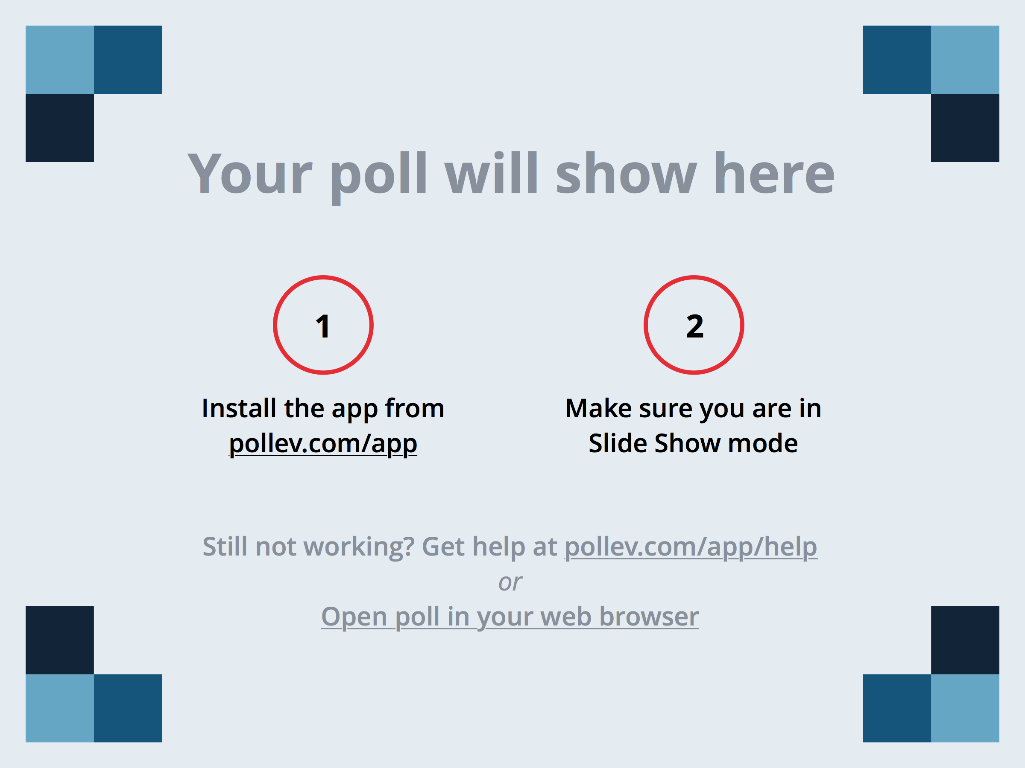
Notes:
What Does "It depends" mean to you? https://www.polleverywhere.com/free_text_polls/4Db0JaERg0g6KAn

Slide 36
Additional Comments
“This is shared responsibility of all Counseling Center and Dean of Students staff. Rotating on call service provided by a combination of both departments.”
“I am utilized for triage appointments during the day and part of our after-hours on-call rotation.”
“We have an emergency duty team that I serve on with 15 other Student Affairs employees that handles after hours emergencies. Counseling Services and/or University Police handles emergencies during normal business hours.”
Notes:
B
Here are ways that some of the universities created shared responsibility so that the case manager is not the only one handling crises 24/7

Slide 37
Additional Comments
“If it is an immediate crisis/emergency, that is handled by the police department and or counseling center clinical case manager. I assist in follow up during business hours.”
“Our counseling center operates a 24-hour crisis line, all clinicians take turns with call.”
“We have an after-hours emergency phone which rotates by week among a pool of volunteers (though it's in my job description to serve in this capacity). I am the back-up to this person 50% of my time, so they are expected to call me when certain incidents happen for consultation and response (i.e. student death, fire, hospitalization, etc.).”
Notes:
B

Slide 38
Additional Comments
“I am the general mental health crisis responder, but in cases where I am unavailable we may use our local CSB or our police department. We also have a designated sexual assault crisis responder.”
“I play a role in threat assessment/crisis management and also being the collector of information, which I'm called on to disseminate. I make sure all the dots are being connected, while also thinking ahead to supports needed once the dust settles.”
Notes:
B

Slide 39
Quality Review and Assessment
Notes:
J

Slide 40
Notes:
J
Hot topic in our work—higher education/student affairs is pushing learning outcomes and assessment
Large focus on student experience

Slide 41
Notes:
J
Some use multiple (ex. Symplicity and paper)
My experience shows determining factors include:
Funding
Pre-existing systems
Individual preference
Thoughts?

Slide 42
Behavioral Intervention Teams
Notes:
B
BITS – Our BIT is called the Student of Concern Committee so forgive me if I go back and forth between BIT and SOC

Slide 43
Notes:
B
HECMA case managers are playing a central role on their BITs
From processing the concerns, documenting, sitting on the team and following up with the students after the meeting.

Slide 44
Notes:
B
Other: All but one response stated that it varies on a case-by-case basis, however the majority either encourage or require follow-up depending on the circumstances. The outlier response pointed out that state law prohibits mandated treatment.

Slide 45
Notes:
B
Other: The responses that fell into the “other” category all stated that it depends on the situation and is determined on a case-by-case basis.

Slide 46
Consequences of Not Meeting
Common tactics used include:
Conduct/sanctions
Holds
Behavioral contract
Many responses mentioned:
Case-by-case nature of how determinations are made
Not able to “require” meetings
Encourage response
Notes:
B
cm’s use a case-by-case decision – for example, some cm’s cm will send a polite request the first time for a meeting as long as the student is not a danger to others; then if the student does not attend, a letter threatening consequences of sanctions, holds, etc. are identified.

Slide 47
Notes:
B
Here are some examples of resources case managers have at their disposal as BIT resources:
Community providers and standard models of practice are most common.
It’s interesting that there are so few student workers given the high level of confidentiality with BIT cases.

Slide 48
Notes:
B
Other: Includes SIGMA, VTAR, NCHERM, Factor One
VTAR Violence Threat Assessment Risk

Slide 49
Notes:
B
Of those who said “yes,” many noted that it was through the university conduct process. Two noted that it has never been used and the majority noted that it is very rarely used.
Of those who said “no,” two responses noted that they previously had a policy in place but it was removed.
Of those who said “other,” one was unsure about their university’s policy and the other has an interim suspension policy, not an official withdrawal policy.

Slide 50
Future Surveys
Notes:
B
There you have it! All the data that was collected voluntarily from the HECMA membership from 2014-March 2015.
Now we are looking forward to the next survey. We have a proposal to incorporate questions such as these into the application and re-application process. When we do that, we want to take into consideration what data you would like to see. We are gathering via Poll Everywhere, the internet based program you can use right now, by texting ____ _________

Slide 51
What would you like to see?
Poll Everywhere
Notes:
B
CURRENT PROPOSALS:
Break down clinical vs. student affairs more clearly
Organize categories
Different tool
Fewer qualitative options
Additional questions
Considering adding to application renewal

Slide 52
Questions?
Notes:
B & J

